Slide 1
Tutorial:
Structuring (Large) OO Systems
Advanced Software Engineering 475
Andrew McVeigh

Slide 2
Example 1: Smartcards
The example from the lectures

Slide 3
SmartCard example
Dowload the smartcard.zip project from:
  CATE notes
Start Eclipse
  Choose menu ”file/import”
  Select ”General/Existing projects into workspace”
  Selected ”archive file” and choose the smartcard.zip file
To run:
  Choose menu ”Run/Run Configurations”
  Double click on ”Java application”; choose project ”Smartcard”
  For the main class, type: sweng_smartcard.Test or press ”Search”
  Hit the ”run” button

Slide 4
Smartcard – cleaning up the structure
The package structure initially looks as follows:

Slide 5
Smartcard Objectives (1)
Remove the cyclic dependencies using abstract clients
Some questions:
  Why does Smartcard have a reference back to its cardholder?
  How can we get the structure to look like the following?

Slide 6
Smartcard Objectives (2)
Let's introduce a CompanyCardholder class
  Like a Cardholder except it's a company, not a person
Some questions:
  How do we make it so a request can use CompanyCardholder or Cardholder
  (try to avoid CompanyCardholder inheriting from Cardholder!)
  Hint: use abstract server and dependency injection
??

Slide 7
Example 2: JBidWatcher
A real-life 30kloc GUI app

Slide 8
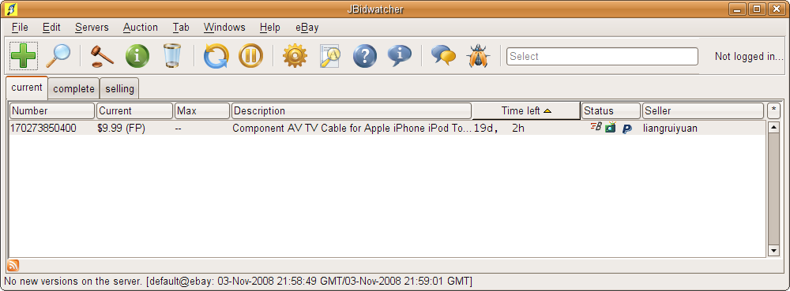
JBidWatcher: jbidwatcher.com
This is a desktop tool for watching, bidding and sniping on eBay auctions
  about 30k lines of code; author Morgan Schweers

Slide 9
JBidWatcher: installing
Dowload the smartcard project from:
  CATE notes
Start Eclipse
  Choose menu ”file/import”
  Select ”General/Existing projects into workspace”
  Selected ”archive file” and choose the jbidwatcher.zip file
To run:
  Choose menu ”Run/Run Configurations”
  Double click on ”Java application”; choose project ”JBidWatcher”
  For the main class, type: com.jbidwatcher.app.JBidWatch
  Hit the ”run” button
  Add in an auction to watch: e.g. item number 320681276370
  (no need to log-in)

Slide 10
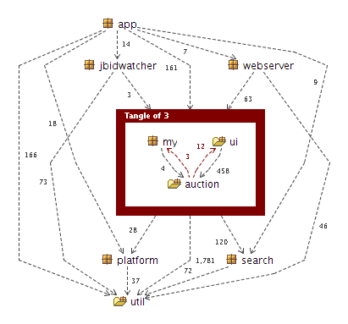
JBidWatcher structure
There's a classic mistake:
the eBay communications logic (auction package) depends on the UI (12 references)

Slide 11
JBidWatcher Objectives (1)
We want to use the .auction package on its own
  i.e. make it into a purely non-UI package we can use to talk to eBay
  We can sort of do this now: e.g. run sweng_jbidwatcher.Test
  (it extracts the details of auction 320681276370)
Remove the dependencies from .auction to .ui
  The user interface (.ui) should depend on the comm logic (.auction), not the other way around!
Hints:
  in the com.jbidwatcher.auction package, the bits to fix are:
    AuctionServer.getConfigurationTabs (refers to JconfigTab)
    AuctionServerManager.getServerConfigurationTabs
    JConfigEbayTab (what is this class not doing in the ui package?)
    ebayServer.getConfigurationTabs
How can we get the UI out of the .auction package?
    Can you think why the author might have put these in .auction?

Slide 12
JBidWatcher Objectives (2)
Advanced exercise
Remove the dependencies from .auction to .my
  Make it so that .auction can be unit tested without reference to MyJBidWatcher!
Questions:
  How does it make it hard to test ebayBidder when MyJBidwatcher is a singleton?
  How can we avoid the singleton, or at least work around it?
  N.B. The above is based on an older version of JbidWatcher
  - newer versions are much cleaner...

Slide 13
JBidWatcher
Some things to think about:
  How does the use of JHTML.Form (e.g. in the Bidder interface) make unit testing hard?
  How can we abstract away from forms and http constructs?
  Would such abstractions make the system easier to work with and understand?
  If you added functionality, how would you know you hadn't broken existing logic?
  Hint: where are the unit tests? Could these be added selectively?
  What is the relationship between good structure and good quality? Can a system have good structure but be horrible quality?
  NB: later version of JBidWatcher are much cleaner... I used an older one on purpose.

Slide 14
Finally...
If you have time, install one of the following:
  Stan4J evaluation (Java, handles 500 classes for free)
  www.stan4j.com
  Structure101 evaluation (Java) www.headwaysoftware.com/products/structure101/index.php
  Ndepend (.Net)
  http://www.ndepend.com/
And then run your example projects through the tool to see how your code compares!

